Slide 1

MEDITATION AND LEADERSHIP
Genius makers presentation

Slide 2
TENDENCIES OF THE MIND
According to the research of Dr. Fred Luskin of Stanford University, a human being has approximately 60,000 thoughts per day—and 90% of these are repetitive.
In 2005, the National Science Foundation published an article summarizing research on human thoughts per day. It was found that the average person has about 12,000 to 60,000 thoughts per day. Of those thousands of thoughts, 80% were negative, and 95% were exactly the same repetitive thoughts as the day before.
There was another interesting study (Leahy, 2005, Study of Cornell University), in which scientists found that, firstly 85% of what we worry about never happens. 97% of our worries are baseless and result from an unfounded pessimistic perception.

Slide 3
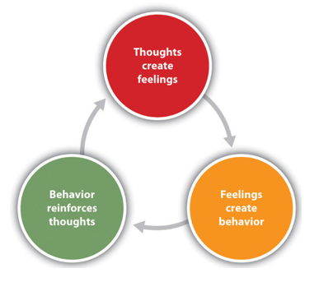
Tendencies of the mind

Slide 4
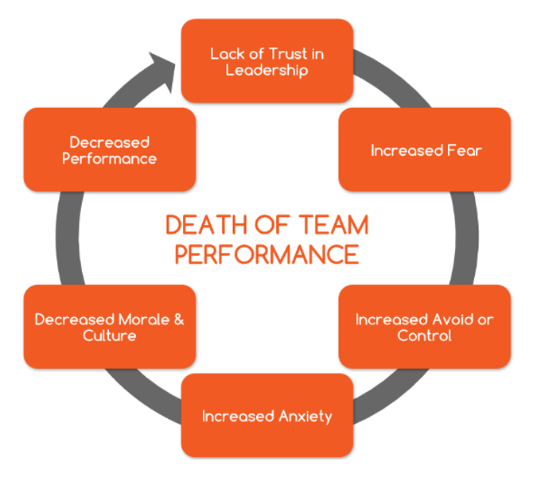
Toxic leadership

Slide 5
WHAT IS MEDITATION?
Meditation is a practice where an individual uses a technique – such as mindfulness, or focusing the mind on a particular object, thought, or activity – to train attention and awareness, and achieve a mentally clear and emotionally calm and stable state. - Wikipedia
MRI scans show that after an eight-week course of mindfulness practice, the brain’s “fight or flight” center, the amygdala, appears to shrink. As the amygdala shrinks, the pre-frontal cortex – associated with higher order brain functions such as awareness, concentration and decision-making – becomes thicker. – Scientific American

Slide 6
How Meditation Benefits CEOs
By Emma Seppälä
Harvard business review
Meditation builds resilience.
  Resilience is the capacity to recover quickly from difficulties.
  Resilience is toughness.
  Meditation has the potential to decrease anxiety, thereby potentially boosting resilience and performance under stress.
Meditation boosts emotional intelligence.
  Meditation can help strengthen your ability to regulate your emotions.
Meditation enhances creativity.
  Research on creativity suggests that we come up with our greatest insights and biggest breakthroughs when we are in a more meditative and relaxed state of mind.
  Meditation encourages divergent thinking (i.e. coming up with the greatest number of possible solutions to a problem), a key component of creativity.

Slide 7
How Meditation Benefits CEOs
By Emma Seppälä
Harvard business review
Meditation improves your relationships.
  While stress narrows your perspective and that of your team, and reduces empathy, negatively impacting performance,
  meditation can help boost your mood and increase your sense of connection to others,
  even make you a kinder and more compassionate person.
Meditation helps you focus.
  Research has shown that our minds have a tendency to wander about 50% of the time.
  Meditation training can help curb our tendency for distraction, strengthening our ability to stay focused and even boosting memory.

Slide 8
What Meditation Can Do for Your Leadership
By Matthias birk
Harvard business review
Transcend the ego
  Our ego wants us to be right, and it perceives failure as a threat.
  Leadership expert Jim Collins found in his study on what makes companies sustainably great that in two thirds of the comparison cases, it was “the presence of a gargantuan ego that contributed to the demise or continued mediocrity of the company.”
  Mindfulness meditation is an antidote to ego. It creates what Harvard neuroscience researchers describe as “self-transcendent” experiences, where meditators begin to notice that there is no stable self that is separate from others, but rather they are part of a whole.

Slide 9
What Meditation Can Do for Your Leadership
By Matthias birk
Harvard business review
Seeing things more objectively
  With meditation practice, as our fixation on ego drops away, our tendency to take things personally drops away as well.
  “I will breathe and contemplate for a few minutes and something that was formerly frustrating becomes almost playful. I can pay attention to details and may see things I had not seen before”. - Scott Shute, former VP of Customer Operations at LinkedIn
  “My mind was racing, I felt frustrated and wrongly accused. After meditating I re-read the email. My mind was calm, and I had to smile. I had made the email all about myself and had taken his criticism personally. Afterward I could see it as what it was — just several specific things that needed to get done.” – Jeff, President of large retailer

Slide 10
What Meditation Can Do for Your Leadership
By Matthias birk
Harvard business review
Forming deeper relationships
  See and communicate the facts clearly, without fear or emotional attachment as before
  Change leaders’ relationships, allowing them to lead with deeper empathy and connection
  the whole construct of having adversarial feelings towards others as independent entities stopped making any sense.

Slide 11
What Meditation Can Do for Your Leadership
By Matthias birk
Harvard business review
Develop a practice focused on stilling the mind.
Practice regularly — every day.
Find extended periods for silence.
Apply the insights of self-transcendence to problems throughout the day.

Slide 12
Meditation apps or techniques
Headspace
Calm
Buddhify
Yoga
Tai Chi
Mantra Meditation
Transcendental Meditation
Breathing Exercises

Slide 13
How to meditate
Find a place where you won’t be disturbed.
Sit in a comfortable position and set a timer.
Gently close your eyes.
Ask yourself what you are currently experiencing, and observe your feelings, sensations, and thoughts.
Shift your attention to your body and spend a moment or two zooming in on the sensations in places that touch the chair or floor.
Shift attention to your belly and observe your sensations. Focus on how it extends and falls with every breath.
Observe your breathing some more without changing it.
At some moment, your mind will naturally wander away.
When you realize that your mind is no longer in the present, recognize it as a moment of awareness and shift your attention back to your breathing.
Now focus on your whole body, observing your posture and face. When you are ready — or when the timer reminds you that you should get back to work — open your eyes.

Slide 14
Meditation quotes
“If you just sit and observe, you will see how restless your mind is. If you try to calm it, it only makes it worse. But over time it does calm and when it does, there’s room to hear more subtle things – that’s when your intuition starts to blossom and you start to see things more clearly and be in the present more. Your mind just slows down and you see a tremendous expanse in the moment. You see so much more than you could see before.”
– Steve Jobs
“The main business case for meditation is that if you’re fully present on the job, you will be more effective as a leader. You will make better decisions and you will work better with other people. I tend to live a very busy life. This keeps me focused on what’s important.”
– William George, Board Member, Goldman Sachs
“Mindfulness will make your life work better and your work life better. It’s a win-win!”
– Mirabai Bush, Google’s adviser for ”Search Inside Yourself,” the company’s corporate mindfulness program

Slide 15
Thank you, genius makers!

